Slide 1
Gesture-Controlled Virtual Mouse
made by Ayush Kumar and
deepanshu singh

Slide 2
Indroduction A wireless mouse or a Bluetooth mouse still uses devices because a battery is needed for power and a dongle is needed to connect the mouse to the PC. The proposed AI virtual mouse system can solve this problem by using a webcam or built-in camera to record hand motions and identify hand tips using computer vision and with voice command. The computer can be controlled digitally and can do left-click, right-click, scrolling, and computer cursor functions based on hand motions without the need for a physical mouse. Deep learning is the basis for the hand detection method. The mouse is one of HCI's (Human Computer Interaction) incredible inventions. As a result, by eliminating human contact and the requirement for external devices to operate the computer. Gesture Controlled Virtual Mouse makes human-computer interaction simple by making use of Hand Gestures.

Slide 3
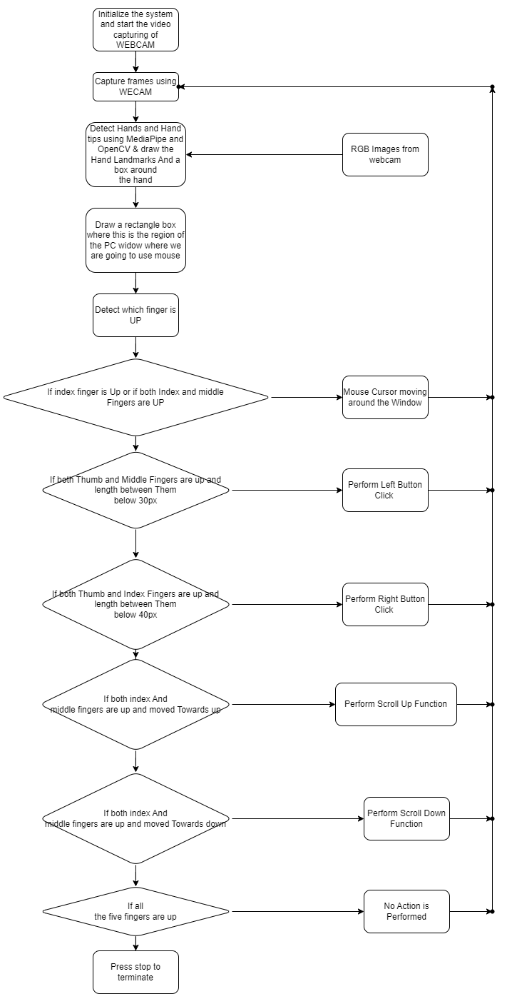
Flow chart

Slide 4
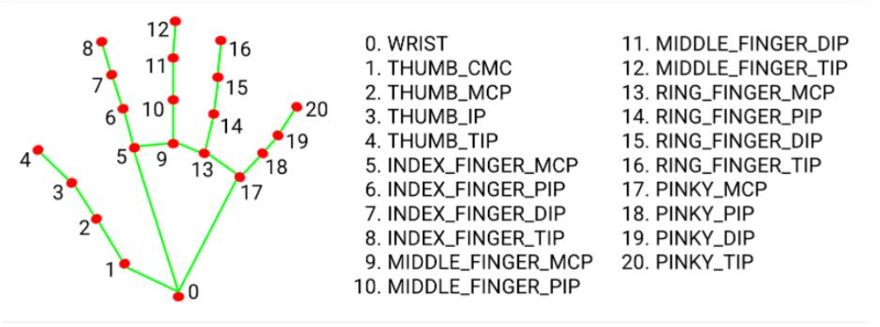
Algorithm used
MediaPipe
MediaPipe is an open-source, cross-platform Machine Learning framework used for building complex and multimodal applied machine learning pipelines. It can be used in Machine Learning Models like face detection, multi-hand tracking, object detection, and tracking, and many more.

Slide 5
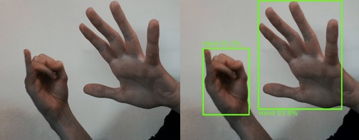
Deep Learning OpenCV OpenCV is a library of programming functions mainly aimed at real-time computer vision. Hand Keypoint detection is the process of finding the joints on the fingers as well as the finger-tips in a given image. a. Human–computer interaction (HCI) b. Motion understanding c. Object detection

Slide 6
Thank you

